Slide 1
IOT BASED SMART PLANT MONITORING SYSTEM USING NODE MCU
GROUP MEMBERS:
Ashik Hebbar
Abhishek
Amith D P
Prajay S P

Slide 2
INTRODUCTION
The IoT-based Smart Plant Monitoring System is a cutting-edge solution designed to revolutionize plant care by harnessing the power of Internet of Things (IoT) technology. This innovative system allows users to monitor and manage the health and growth of their plants with unprecedented precision and convenience

Slide 3
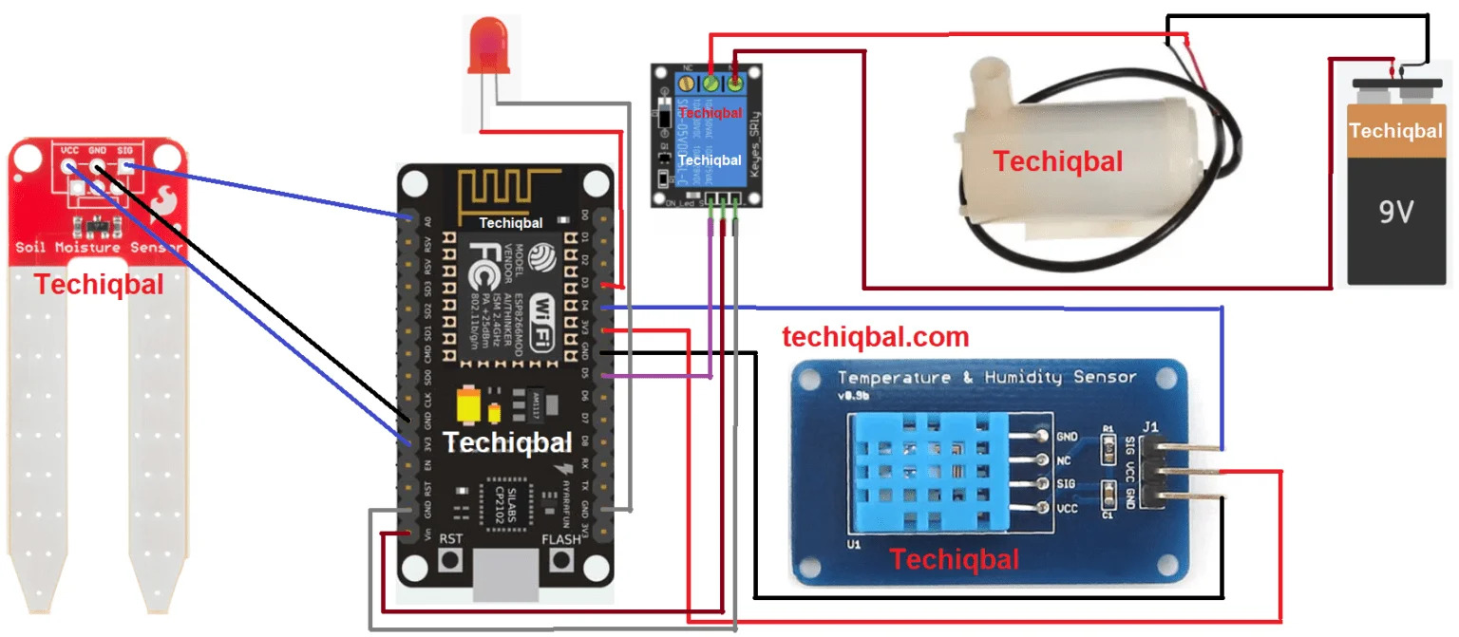
Block diagram :

Slide 4
WORKING
Sensor Data Collection: Sensors placed near the plant gather data on soil moisture, temperature, humidity, light, and nutrients.
2. Data Transmission: Collected data is sent wirelessly to a central hub device, typically via IoT protocols.
3. **Cloud-Based Analysis:** Data is analyzed in the cloud using algorithms to provide insights into plant health and environmental conditions.
4. **User Interface:** Users access real-time updates, alerts, and recommendations through a mobile app or web dashboard.
5. **Alerts and Notifications:** Automated alerts notify users of critical deviations, prompting timely action to ensure plant health.
6. **Historical Data Storage:** The system stores historical data for trend analysis and optimization of plant care strategies.
7. **User Control:** Users can remotely monitor plants, adjust settings, and view historical data, empowering them to optimize plant care based on individual needs and preferences.

Slide 5
Applications:
Home Gardening: Ideal for hobbyists and enthusiasts looking to maintain healthy indoor and outdoor gardens with minimal effort
.
Commercial Agriculture: Suitable for large-scale agriculture operations, allowing farmers to optimize crop yields and resource utilization while reducing the risk of crop failure.
Research and Education: Valuable tool for researchers, educators, and students studying plant biology, ecology, and environmental science.

Slide 6
ADVANTAGES
Optimized Plant Health: By providing real-time insights and personalized recommendations, the Smart Plant Monitoring System helps users optimize the health and growth of their plants, resulting in healthier, more vibrant green spaces.
Efficiency and Convenience: The system eliminates the guesswork and manual effort involved in traditional plant care methods, offering users a convenient and hassle-free way to monitor and manage their plants remotely.
Resource Conservation: By ensuring efficient use of water, nutrients, and energy, the system promotes sustainability and resource conservation, making it an environmentally friendly choice for plant care

Slide 7
SENSORS
Three sensor used in the system which are mainly as follows:
Soil moisture
Humidity and temperature

Slide 8
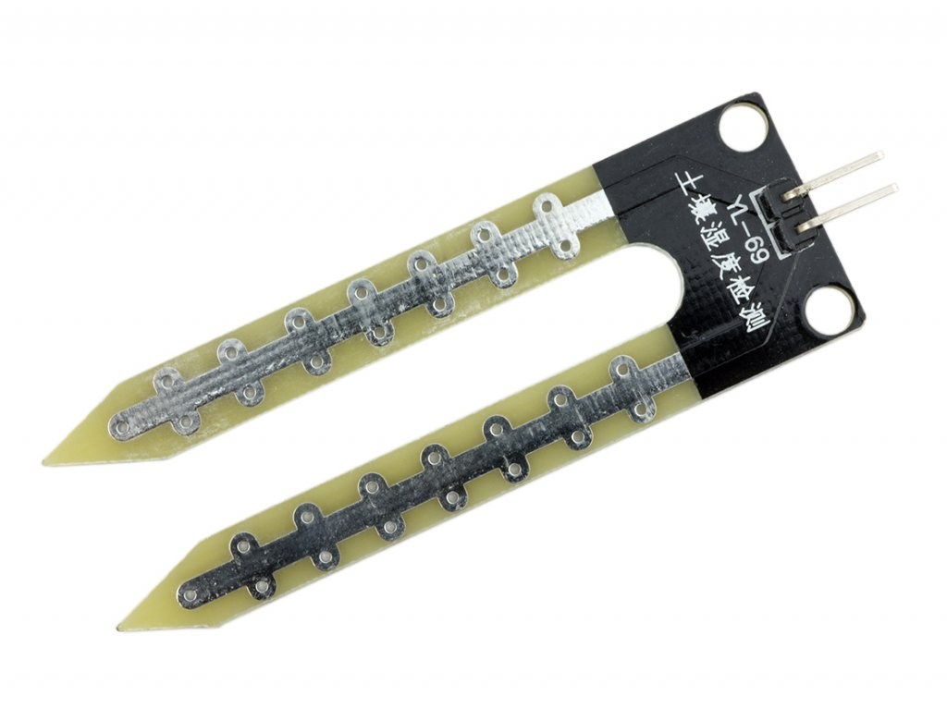
SOIL MOISTURE SENSORS
Common type is a frequency domain sensor .
Neutron moisture gauge.
In this sensor we are using 2 probes to be dipped into the soil as per moisture we will get analog output variations from 0.60-12 volts.

Slide 9
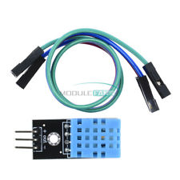
TEMPERATURE AND HUMIDITY SENSORS
It measures both air temperature and moisture .
Relative humidity expressed as a percentage .
HS1100 is used for sensing humidity .
The output in terms of frequency range 5khz to 10khz.

Slide 10
REFERENCES
www.ijert.org/ smart – plant monitoring –system –using –wireless-sensor-network

Slide 11
THANK YOU

